Slide 1


Print Job Scheduler

Slide 2
INTRODUCTION
This C program is a simulation of a print queue system that supports different scheduling policies: Priority, FIFO (First-In-First-Out), and SJN (Shortest Job Next). The system also includes authentication for computers trying to add print jobs.

Slide 3
Data Structures:
PrintJob: Represents a print job with attributes such as the number of pages to print, priority, computer ID, and job ID.
PrintQueue: Implements a print queue using an array to store print jobs. It includes functions for initializing, enqueueing, dequeuing, and printing the queue.
BSTNode: Represents a node in a binary search tree (BST) for the SJN scheduling policy.

Slide 4
Main Function:
Initializes the scheduling policy, an array of computers, a print queue, and a binary search tree.
Enters a loop where the user can choose various options to interact with the print queue system, such as adding a print job, finishing a print job, checking the next job, checking wait time, removing a print job, printing the entire queue, or exiting the program.
For each option, appropriate functions are called to perform the corresponding actions.

Slide 5
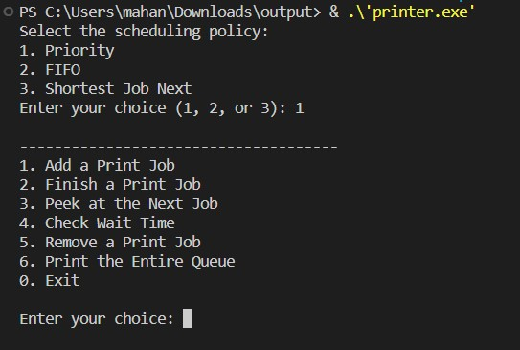
OUTPUT SCREENSHOTS:

Slide 6
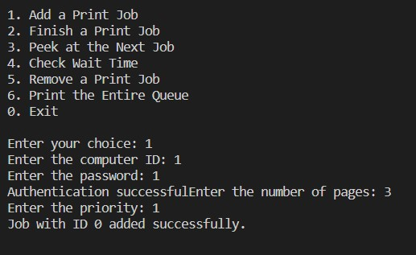

Slide 7
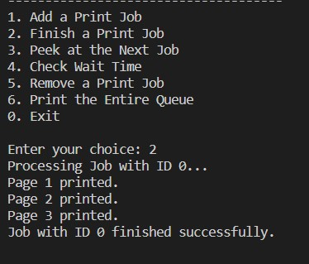

Slide 8
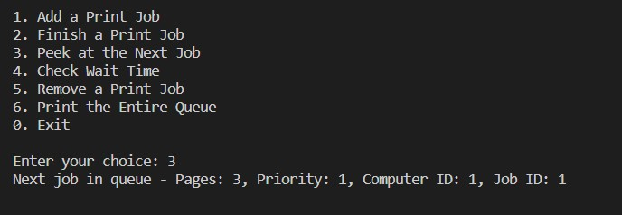

Slide 9
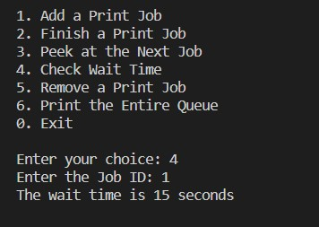

Slide 10
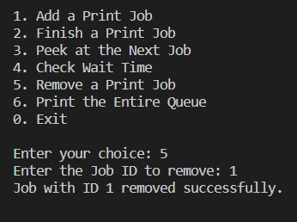

Slide 11
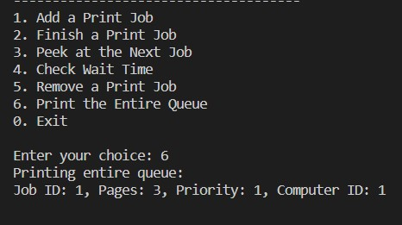

Slide 12
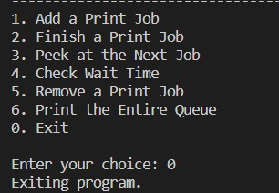

Slide 13


